Slide 1
Review of SQL DML
Chapter 3

Slide 2
Objectives
This lesson covers the following objectives:
Insert data into a database table using SQL &PL/SQL
Update data in a database table using SQL &PL/SQL
Delete data from a database table using SQL &PL/SQL
Merge data into a database table using SQL &PL/SQL

Slide 3
Data Manipulation Language (DML)
You can use DML commands to add rows, delete rows and modify the data within a row
The DML commands are INSERT, UPDATE, DELETE, and MERGE
If you have a locally installed version of APEX, there is an AUTOCOMMIT checkbox that can be unchecked to disable AUTOCOMMIT
When AUTOCOMMIT is disabled, DML commands produce permanent changes only when the COMMIT
command is issued either within a PL/SQL block or by itself
If the user logs off normally or closes the browser window before executing a COMMIT command, the changes will be rolled back

Slide 4
INSERT
You use the INSERT statement to add new rows to a table
It requires at least two items:
The name of the table
Values for each of the columns in the table
(Optional, but recommended) The names of the columns that will receive a value when the row is inserted
If this option is used, then the list of values must match the list of columns
At the very least, you must list and initialize with a value each column that can not be NULL

Slide 5
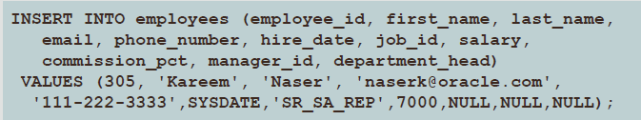
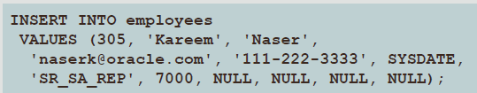
User can Insert values using two ways:
INSERT WITH COLUMN NAME (INSERT Explicit Syntax)
INSERT WITHOUT COLUMN NAME (INSERT Implicit Syntax)

Slide 6
UPDATE
The UPDATE statement is used to modify existing rows in a table
It requires at least three items:
The name of the table
The name of at least one column to modify
A value for each column being modified
(Optional) a WHERE clause that identifies the row or rows to be modified
If the WHERE clause is omitted, ALL rows will be modified
Be very careful when running an UPDATE statement without a WHERE clause!

Slide 7


UPDATE Syntax
A single column can be modified
The WHERE clause identifies the row to be modified
An UPDATE statement can modify multiple columns

Slide 8
DELETE
You use the DELETE statement to remove existing rows in a table
The statement requires at least one item:
The name of the table
(Optional) a WHERE clause that identifies the row or rows to be deleted
Please note, if the WHERE clause is omitted, ALL rows will be deleted
Be very careful when running a DELETE statement without a WHERE clause
Situations requiring that will be rare

Slide 9
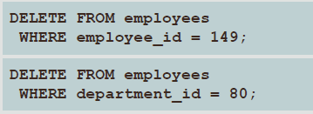
DELETE Syntax
The WHERE clause identifies the row or rows to be deleted
Be careful with the DELETE statement
If the WHERE clause is omitted, ALL rows will be deleted
Very few situations will require a DELETE statement without a WHERE clause

Slide 10
MERGE
The MERGE statement will INSERT a new row into a target table or UPDATE existing data in a target table, based on a comparison of the data in the two tables
The WHEN cIause determines the action to be taken
For example, if a specific row exists in the source table, but there is no matching row in the target table, the row from the source table will be inserted into the target table
If the matching row does exist in the target table, but some data in the source table is different for that row, the target table may be updated with the different data

Slide 11

MERGE Usage and Syntax
To set up our MERGE example, consider a situation where we need to calculate annual bonuses for employees earning less than $10,000 USD
First, we create a table called bonuses

Slide 12

MERGE Usage and Syntax
We then populate the table with the employee ids of all employees with a salary less than $10,000 USD

Slide 13
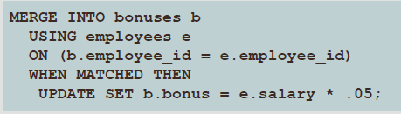
MERGE Usage and Syntax
Each employee with a salary less than $10,000 USD is to receive a bonus of 5% of their salary
To use the salary column from the employees table to calculate the amount of the bonus and update the bonus column in the bonuses table, we use the following MERGE statement

Slide 14
SQL Statements in PL/SQL
You can use the following kinds of SQL statements in PL/SQL:
SELECT statements to retrieve data from a database
DML statements, such as INSERT, UPDATE, and DELETE, to make changes to the database
Transaction control statements, such as COMMIT, ROLLBACK, or SAVEPOINT, to make changes to the database permanent or to discard them
Transaction control statements will be covered later and are not available in the iAcademy-hosted APEX environment

Slide 15
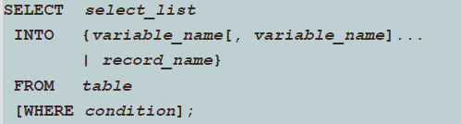
SELECT Statements in PL/SQL
Retrieve data from a database into a PL/SQL variable with a SELECT statement so you can work with the data within PL/SQL
select_list is a list of at least one column and can include SQL expressions, row functions, or group functions
variable_name is a scalar variable that holds a retrieved value
record_name is the PL/SQL record that holds the retrieved values
table specifies the database table name
condition is composed of column names, expressions, constants, and comparison operators, including PL/SQL variables and constants

Slide 16
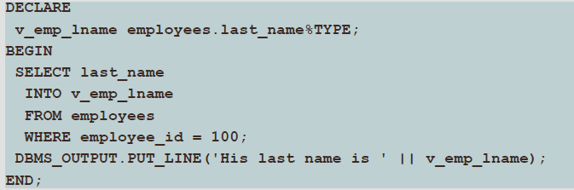
Using the INTO Clause
The INTO clause is mandatory and occurs between the SELECT and FROM clauses
It is used to specify the names of PL/SQL variables that hold the values that SQL returns from the SELECT clause

Slide 17
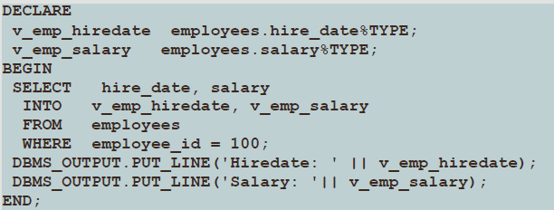
Retrieving Data in PL/SQL Example
You must specify one variable for each item selected, and the order of the variables must correspond with the order of the items selected

Slide 18
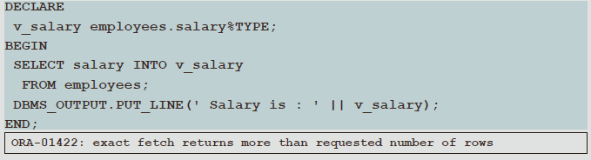
Retrieving Data in PL/SQL Embedded Rule
SELECT statements within a PL/SQL block fall into the ANSI classification of embedded SQL for which the following rule applies: embedded queries must return exactly one row
A query that returns more than one row or no rows generates an error

Slide 19
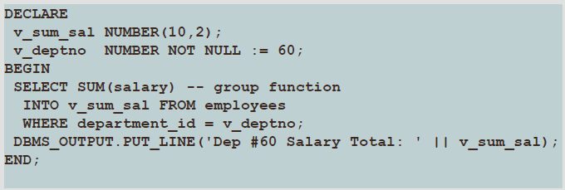
Retrieving Data in PL/SQL Example
Return the sum of the salaries for all the employees in the specified department

Slide 20
Question
1. Using an Employee table write PL/SQL to retrieve first_name, and maximum salary for all employees whose employee_id is 100.

Slide 21

Create Copy of Original Table
It is very important that you do NOT modify the existing tables (such as EMPLOYEES and DEPARTMENTS), because they will be needed later in the course
The examples in this lesson use the COPY_EMP table
If you haven't already created the COPY_EMP table, do so now by executing this SQL statement:

Slide 22
Manipulating Data Using PL/SQL
Make changes to data by using DML commands within your PLSQL block:
INSERT
UPDATE
DELETE
MERGE
A DML statement within a PL/SQL block can modify many rows (unlike a SELECT statement, which must read exactly one row).

Slide 23
Manipulating Data Using PL/SQL
You manipulate data in the database by using the DML commands
You can issue the DML commands— INSERT, UPDATE, DELETE, and MERGE —without restriction in PL/SQL
The INSERT statement adds new rows to the table
The UPDATE statement modifies existing rows in the table
The DELETE statement removes rows from the table
The MERGE statement selects rows from one table to update and/or insert into another table
The decision whether to update or insert into the target table is based on a condition in the ON clause
Note: MERGE is a deterministic statement—that is, you cannot update the same row of the target table multiple times in the same MERGE statement
You must have INSERT and UPDATE object privileges in the target table and the SELECT privilege in the source table

Slide 24
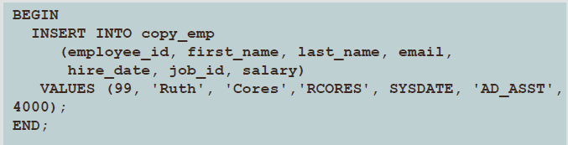
Inserting Data
The INSERT statement adds new row(s) to a table
Example: Add new employee information to the COPY_EMP table
One new row is added to the COPY_EMP table

Slide 25
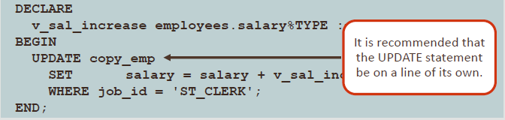
Updating Data
The UPDATE statement modifies existing row(s) in a table
Example: Increase the salary of all employees who are stock clerks

Slide 26
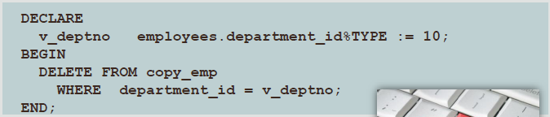
Deleting Data
The DELETE statement removes row(s) from a table
Example: Delete rows that belong to department 10 from the COPY_EMP table

Slide 27
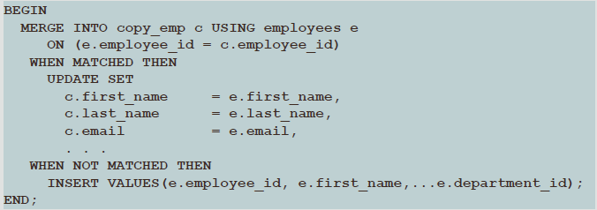
Merging Rows
The MERGE statement selects rows from one table to update and/or insert into another table
Insert or update rows in the COPY_EMP table to match the employees table

Slide 28
Questions
1. Create a copy of the table Departments and answer the following questions:
A. Enter the following values into copied table
(111, ‘IT’, 222, 555) and (222, ‘Bus’, 333, 444)
B. Update department_name from IT to Enginnering for the department_id 111
C. MERGE rows from DEPARTMENTS table to update and/or insert into COPY_DEPT table

Slide 29

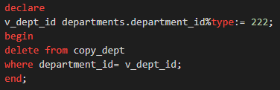
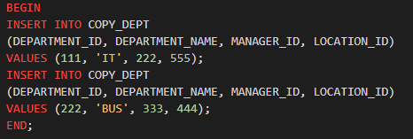
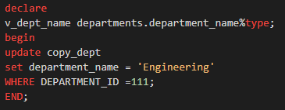
Answers
1.

Slide 30
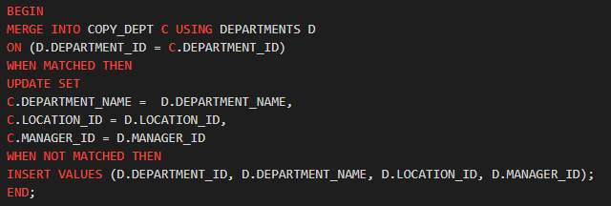

Slide 31
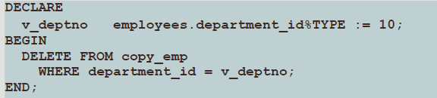
Getting Information From a Cursor
Look again at the DELETE statement in this PL/SQL block
It would be useful to know how many COPY_EMP rows were deleted by this statement
To obtain this information, we need to understand cursors

Slide 32
What is a Cursor?
The word “cursor” has several meanings in Oracle. It is sometimes used to mean a pointer to the private memory area, rather than the memory area itself.
Is a named control structure used by an application program to point and select a row of data from a result set.

Slide 33
Implicit and Explicit Cursors
There are two types of cursors:
Implicit cursors: Defined automatically by Oracle for all SQL data manipulation statements, and for queries that return only one row
An implicit cursor is always automatically named “SQL”. User can’t control the behavior of these cursor.
Explicit cursors: Defined by the PL/SQL programmer for queries that return more than one row
User defined cursor return more than one row
User has a full control

Slide 34
Cursor Attributes for Implicit Cursors
Cursor attributes are automatically declared variables that allow you to evaluate what happened when a cursor was last used
Attributes for implicit cursors are prefaced with “SQL”
Use these attributes in PL/SQL statements, but not in SQL statements
Using cursor attributes, you can test the outcome of your SQL statements

Slide 35
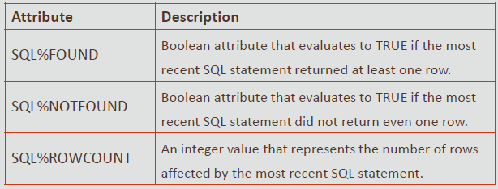
Cursor Attributes for Implicit Cursors

Slide 36
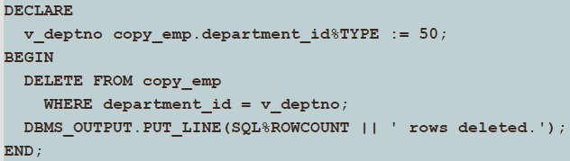
Using Implicit Cursor Attributes: Example 1
Delete rows that have the specified employee ID from the COPY_EMP table
Print the number of rows deleted

Slide 37
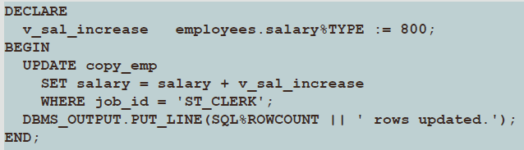
Using Implicit Cursor Attributes: Example 2
Update several rows in the COPY_EMP table
Print the number of rows updated

Slide 38
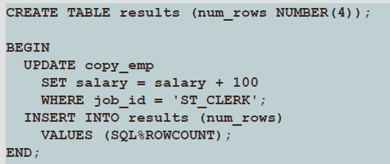
Using Implicit Cursor Attributes: Good Practice Guideline
Look at this code which creates a table and then executes a PL/SQL block
Determine what value is inserted into RESULTS

Slide 39
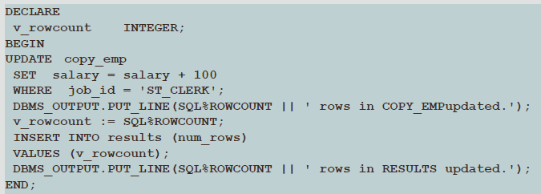
Using Implicit Cursor Attributes: Good Practice Guideline
To INSERT the value in the RESULTS table - we must save the SQL%ROWCOUNT value in a declared variable
The value is displayed using PUT_LINE

Slide 40
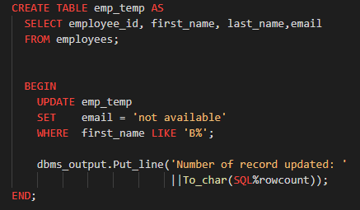
Questions
1. Write a program in PL/SQL to find the number of rows effected by the use of SQL%ROWCOUNT attributes of an implicit cursor?

Slide 41
Database Transaction
A transaction is an inseparable list of database operations that must be executed either in its entirety or not at all
Transactions maintain data integrity and guarantee that the database is always in a consistent state

Slide 42
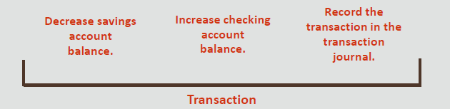
Example of a Transaction
To illustrate the concept of a transaction, consider a banking database
When a bank customer transfers money from a savings account to a checking account, the transaction can consist of three separate operations:

Slide 43
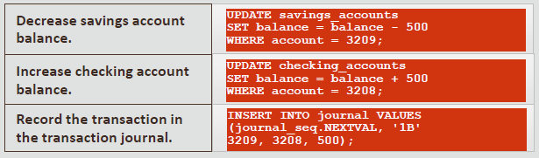
Example of a Transaction

Slide 44
Transaction Control Statements
You use transaction control statements to make the changes to the database permanent or to discard them
The three main transaction control statements are:
COMMIT
ROLLBACK
SAVEPOINT
The transaction control commands are valid in PL/SQL and therefore can be used directly in the executable or exception section of a PL/SQL block

Slide 45

COMMIT
COMMIT is used to make the database changes permanent
If a transaction ends with a COMMIT statement, all the changes made to the database during that transaction are made permanent
The keyword END signals the end of a PL/SQL block, not the end of a transaction
A transaction may include multiple PL/SQL blocks and nested PL/SQL blocks

Slide 46
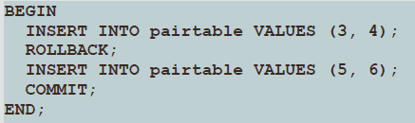
ROLLBACK
ROLLBACK is for discarding any changes that were made to the database after the last COMMIT
If the transaction fails, or ends with a ROLLBACK, then none of the statements take effect
In the example, only the second INSERT statement adds a row of data

Slide 47
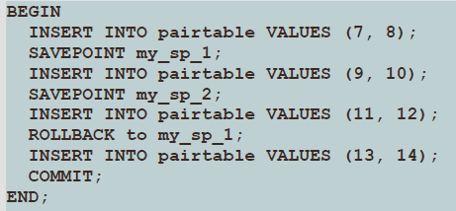
SAVEPOINT
SAVEPOINT is used to mark an intermediate point in transaction processing
ROLLBACK is used to return the data values to the point of a SAVEPOINT

Slide 48
Questions
1. Create Staff Table with the following information
2. Enter the following records and save as T1
Column Name | Data Type
StaffId | Number
StaffName | Varchar2(20)
Email | Varchar2(20)
StaffId | StaffName | Email
121 | Haneen | haneen@gmail.com
131 | Mohamed | Mohd@Hotmail.com
141 | Rehab | Rehab@gmail.com

Slide 49
Questions
3. Update an email from Mohd@Hotmail.com to mohd@gmail.com and save it as T2
4. Insert the records as follows and save it as T3:
5. Delete the StaffId 131 and save it as T4
6. Return back the Transaction after T2 and submit
StaffID | StaffName | Email
151 | Shehab | Shehab@gmail.com

